Slide 1
Neural Network Regularization

Slide 3
Outline
Regularization of NN
Norm Penalties
Early Stopping
Data Augmentation
Dropout

Slide 4
Regularization
Regularization is any modification we make to a learning algorithm that is intended to reduce its generalization error but not its training error.

Slide 5
Outline
Regularization of NN
Norm Penalties
Early Stopping
Data Augmentation
Dropout

Slide 6
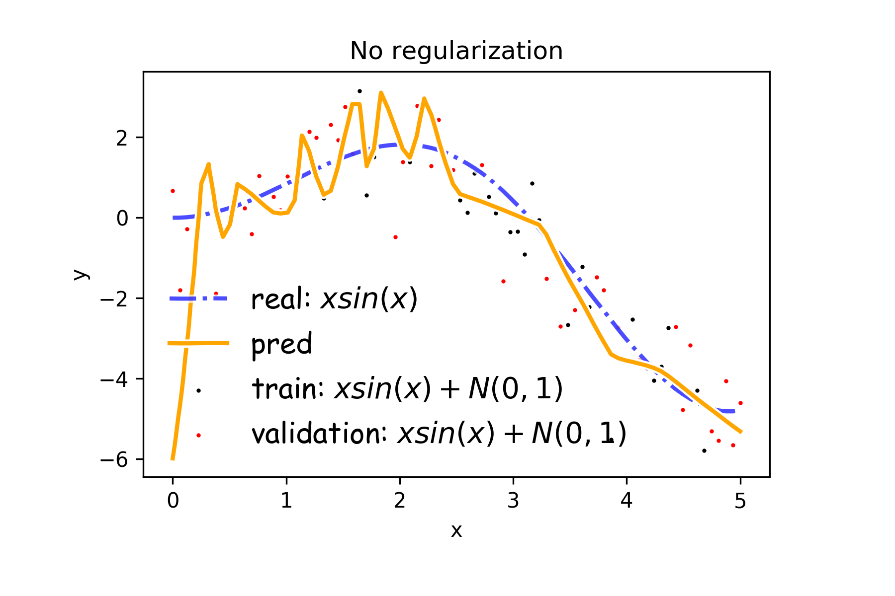
Overfitting
Fitting a deep neural network with 5 layers and 100 neurons per layer can lead to a very good prediction on the training set but poor prediction on validations set.

Slide 7
Norm Penalties
We used to optimize:
$$L\left(W;X, y\right)$$
Change to …
$$L_{R}\left(W;X,y\right)=L\left(W;X, y\right)+αΩ(W)$$
L₂ regularization:
Weights decay
MAP estimation with Gaussian prior
L₁ regularization:
encourages sparsity
MAP estimation with Laplacian prior
Biases not penalized
$$Ω\left(W\right)=\frac{1}{2}∥W∥_{2}^{2}$$
$$Ω\left(W\right)=\frac{1}{2}∥W∥_{1}$$

Slide 8
Norm Penalties
Weights decay in proportion to size
We used to optimize:
$$L\left(W;X, y\right)$$
Change to:
$$L_{R}\left(W;X,y\right)=L\left(W;X, y\right)+αΩ(W)$$
L₂ regularization:
Decay of weights
MAP estimation with Gaussian prior
L₁ regularization:
encourages sparsity
MAP estimation with Laplacian prior
$$W^{(i+1)}=W^{(i)}−λ\frac{∂L}{∂W} \\ L_{R}\left(W;X,y\right)=L\left(W;X, y\right)+\frac{1}{2}α∥W∥_{2}^{2} \\ W^{(i+1)}=W^{(i)}−λ\frac{∂L}{∂W}−λα W^{(i)}$$
Biases not penalized
$$Ω\left(W\right)=\frac{1}{2}∥W∥_{2}^{2}$$
$$Ω\left(W\right)=\frac{1}{2}∥W∥_{1}$$

Slide 9
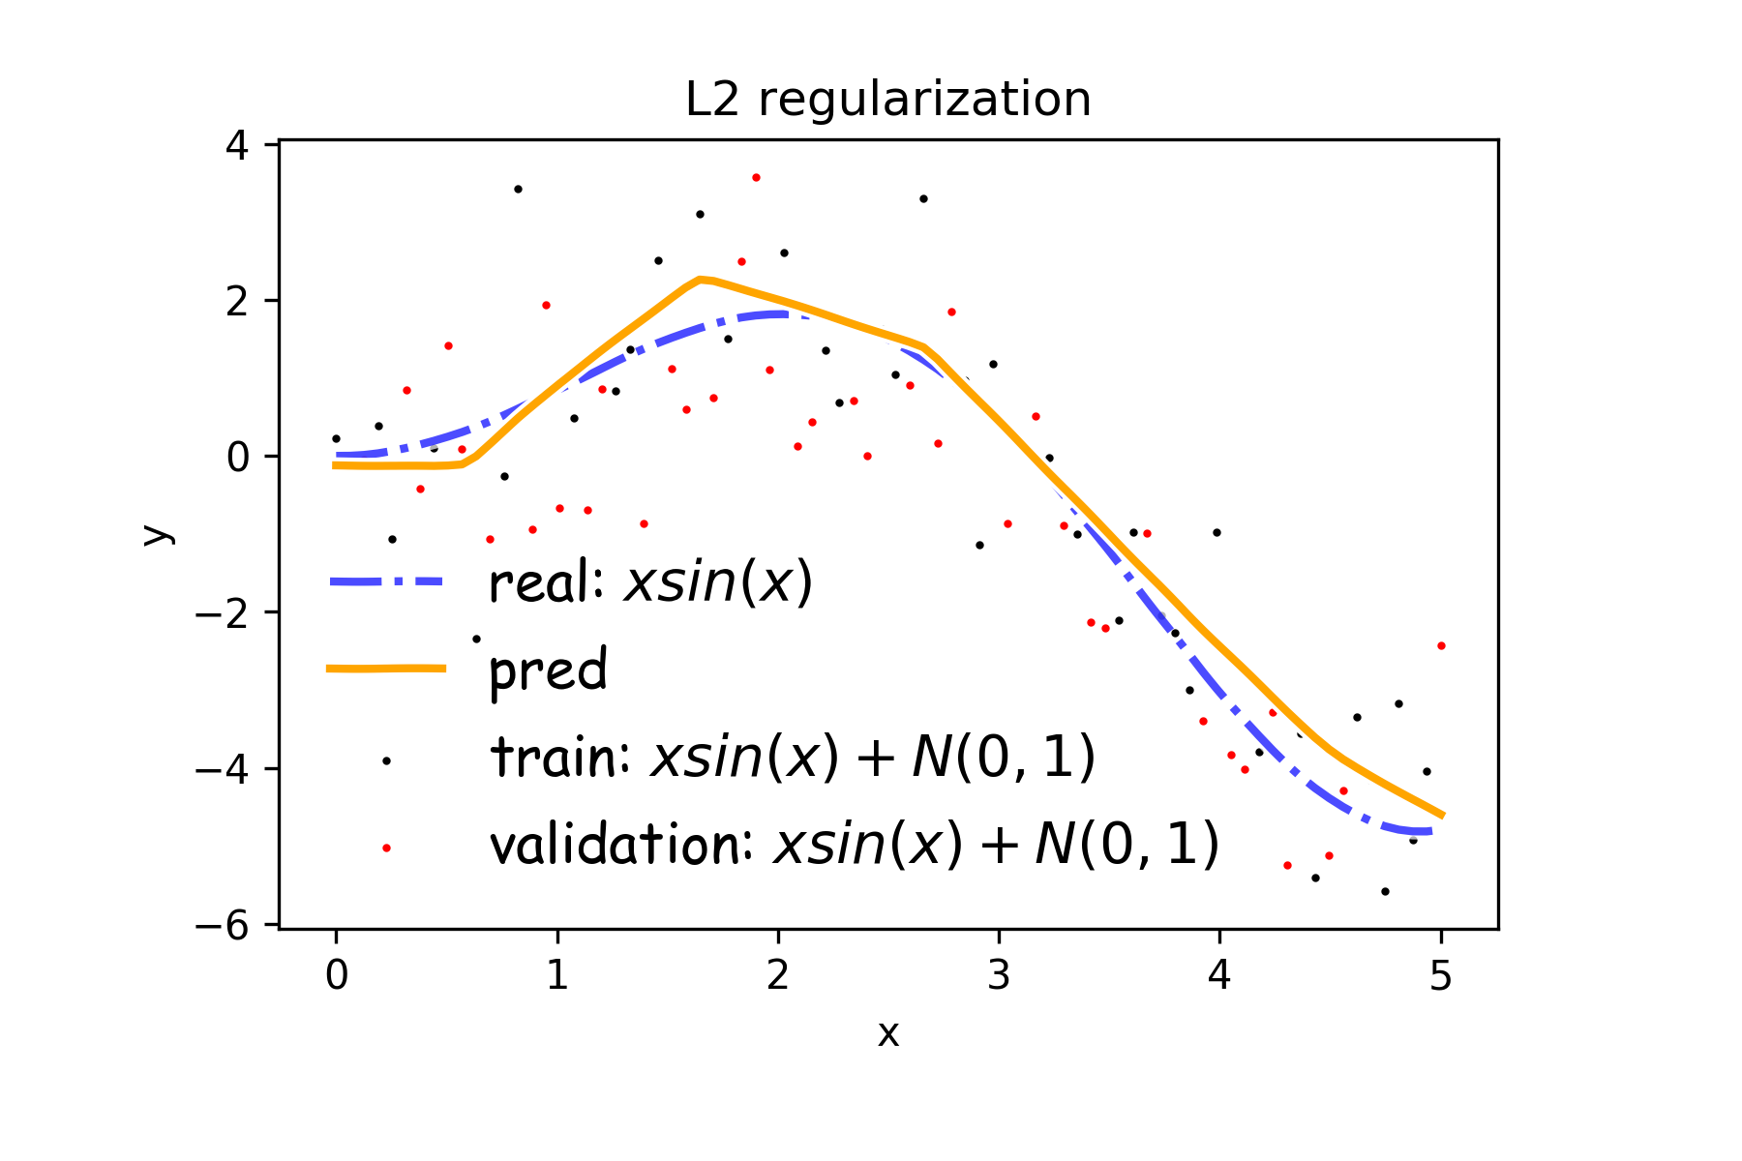
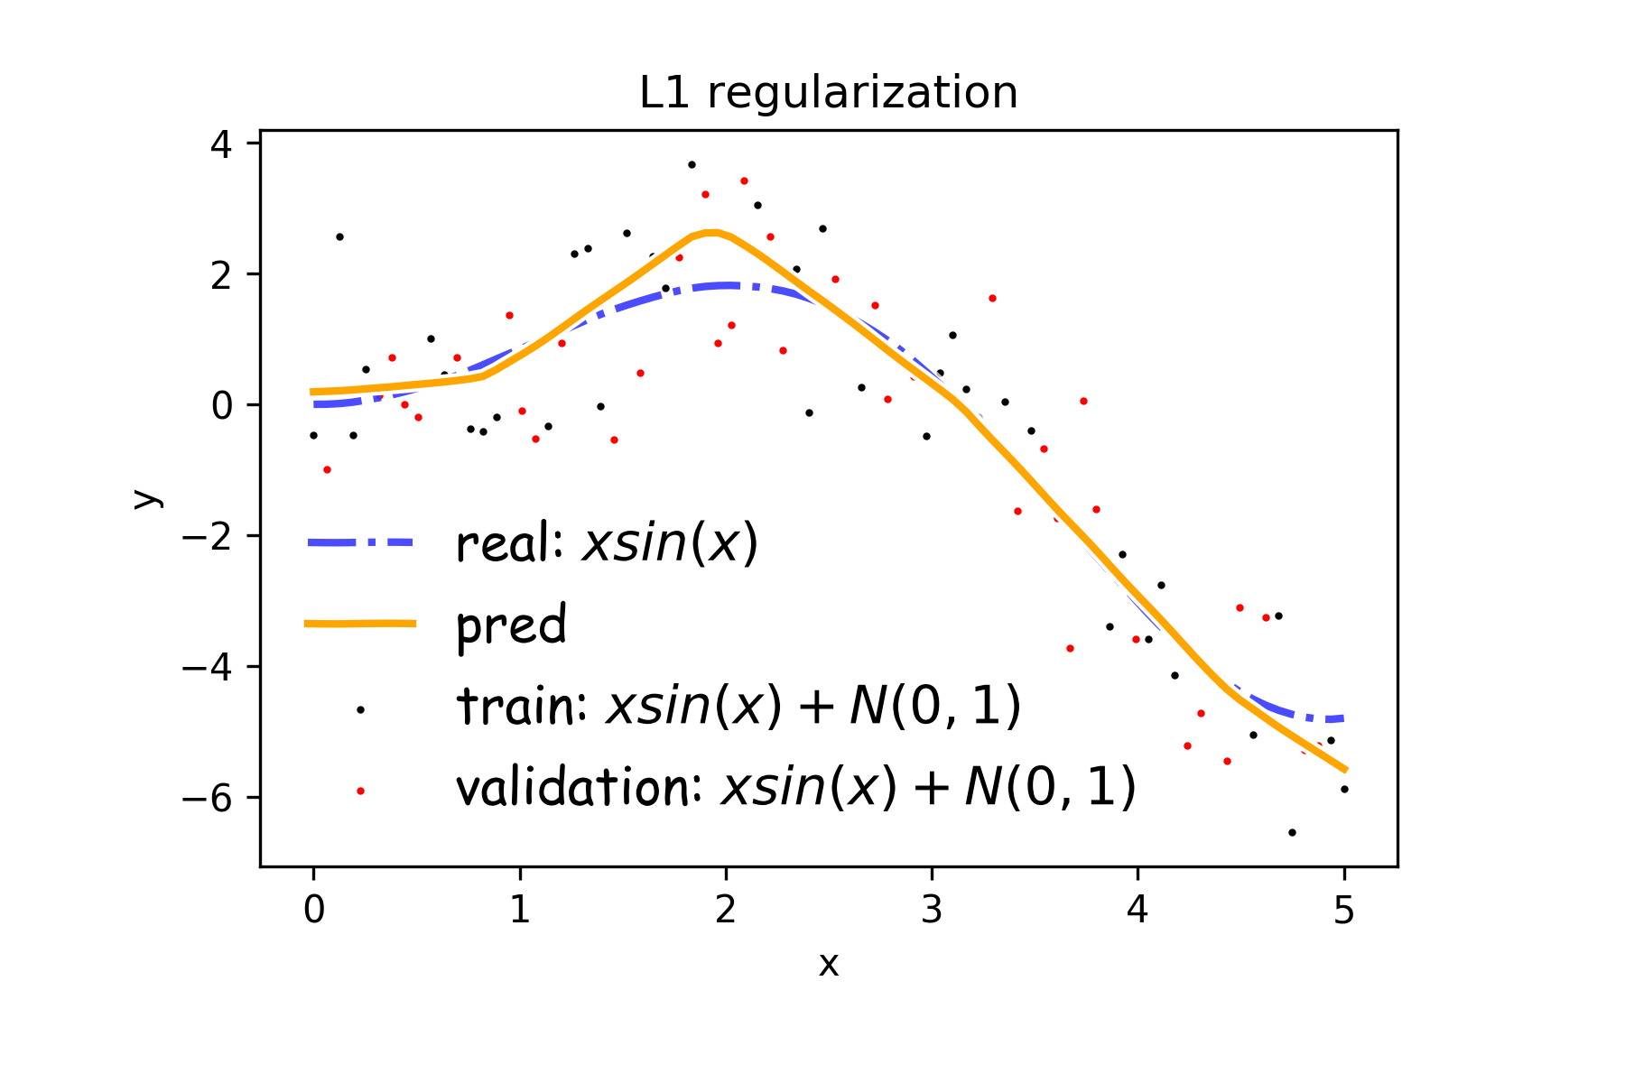
Norm Penalties
$$Ω\left(W\right)=\frac{1}{2}∥W∥_{2}^{2}$$
$$Ω\left(W\right)=\frac{1}{2}∥W∥_{1}$$

Slide 10
Exercise: Regularization using L1 and L2 Norm

Slide 11
Outline
Regularization of NN
Norm Penalties
Early Stopping
Data Augmentation
Dropout

Slide 12
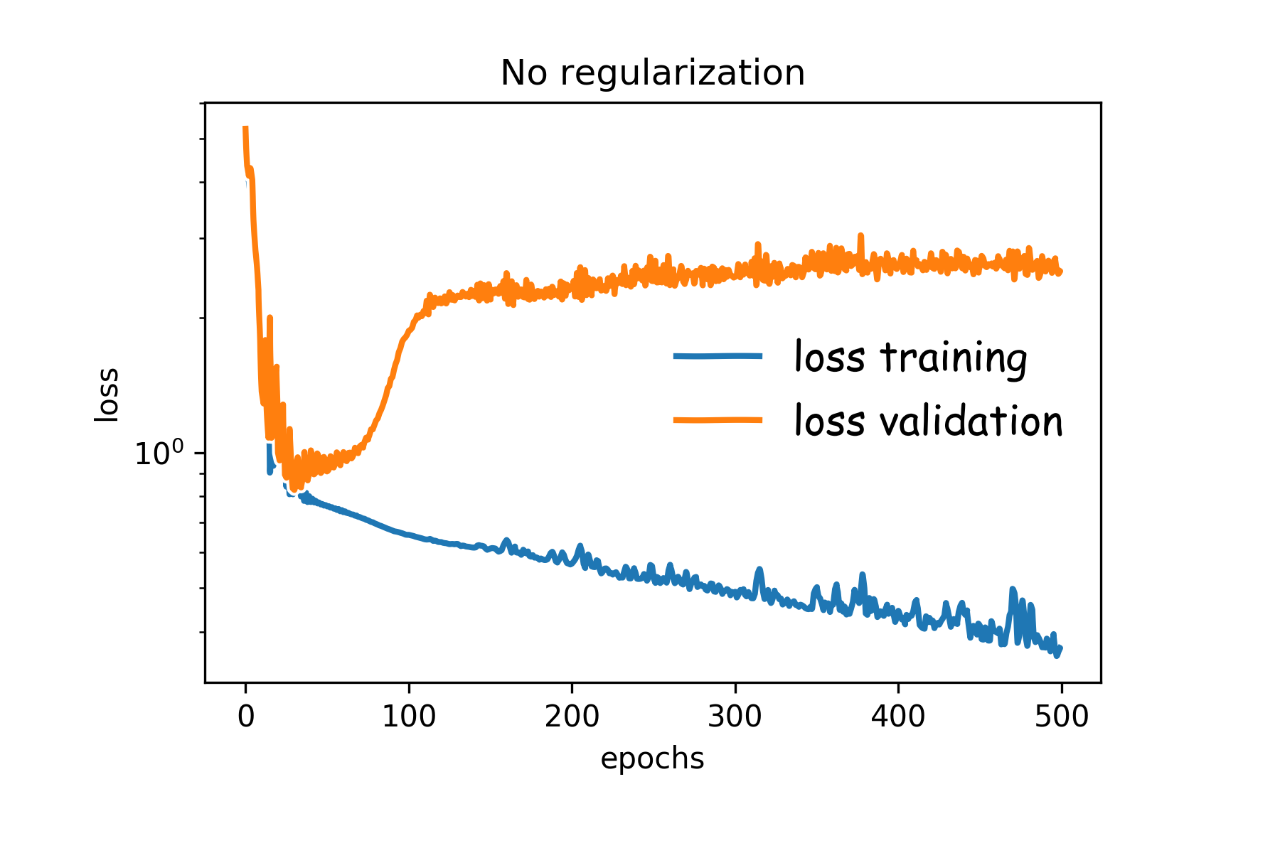
Early Stopping
Early stopping: terminate while validation set performance is better. Sometimes is worth waiting a little before stopping. This is called patience.
Patience is defined as the number of epochs to wait before early stop if no progress on the validation set.
The patience is often set somewhere between 10 and 100 (10 or 20 is more common), but it really depends on the dataset and network.

Slide 13
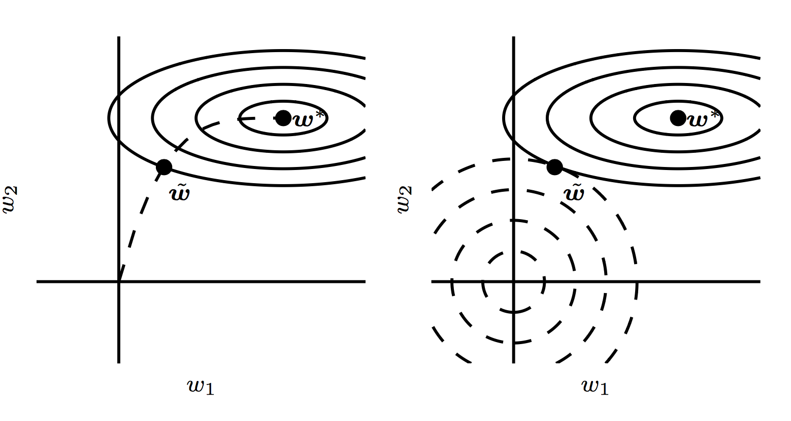
Early Stopping

Slide 14
Exercise: Early Stopping

